Slide 1
Cereal Data Analysis
By Kaustubha Ram P

Slide 2
KPIs
Average Rating per Brand
Sodium, potassium, fat, carbohydrates, vitamins, sugars, protein, fiber quantity per brand

Slide 3
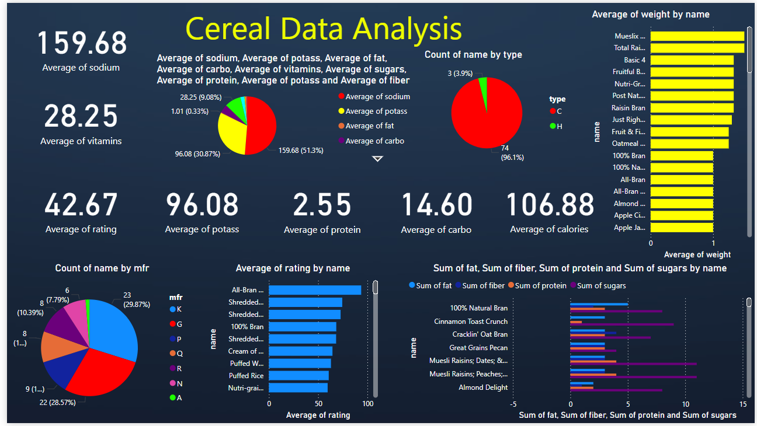
Dashboard

Slide 4
Key Insights
C type has highest quantity
K and G are the highest manufacturers
All Bran had the highest average rating

Slide 5
Thank You

